Slide 1



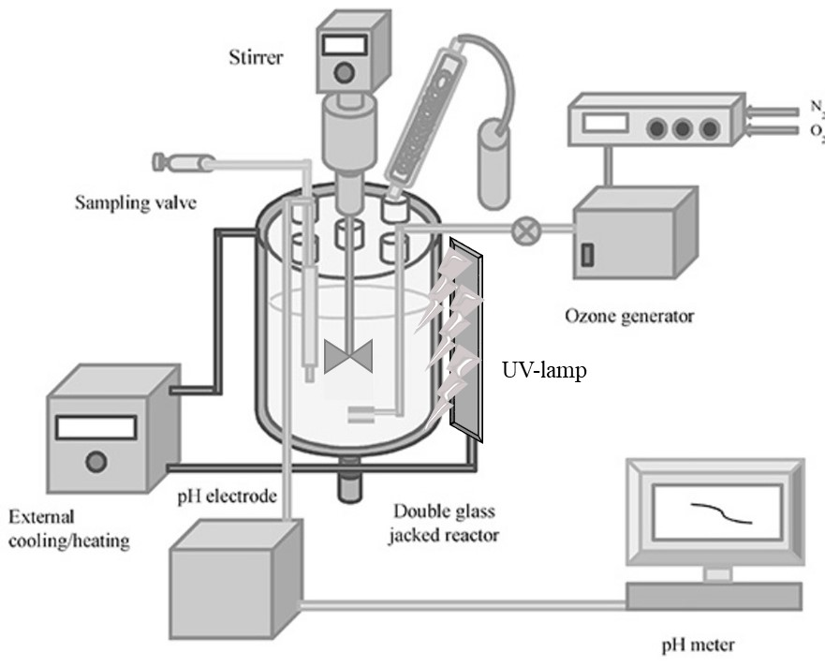
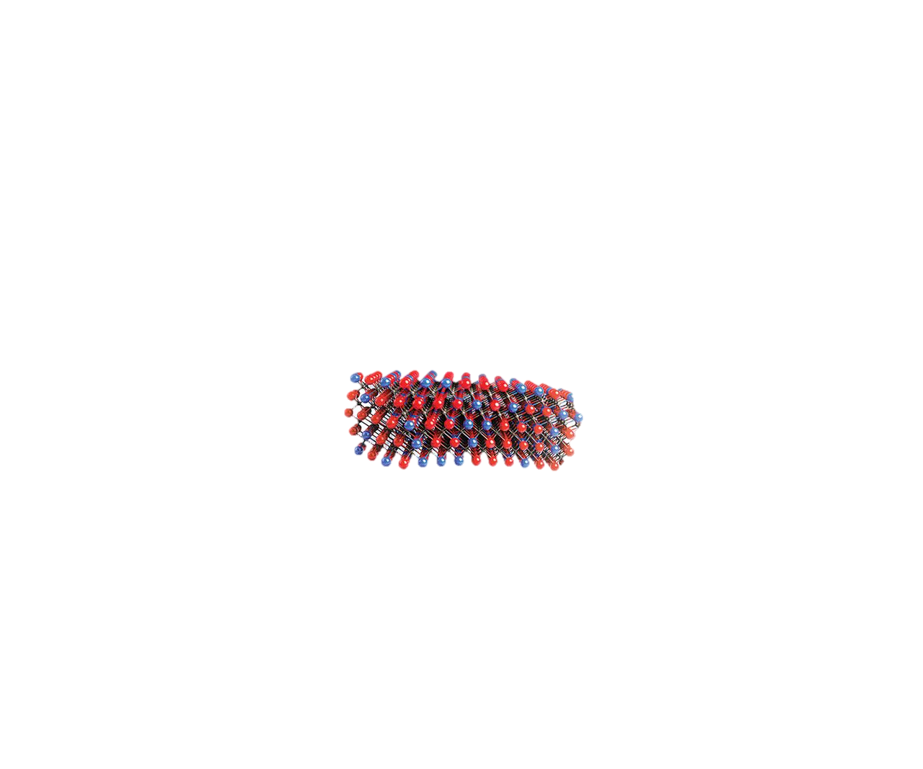
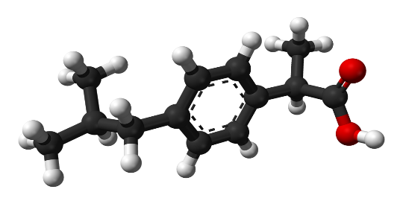

UNIVERSITY OF NAPOLI “FEDERICO II”
POLYTECHNIC AND SCIENCE SCHOOL
Department of Chemical Sciences
Ph.D. School in Chemical Sciences (36 Cycle)
Third year activity
Innovative materials
for
water purification
PhD candidate:
Maryam Hmoudah
CeO₂-Mxene
Ibuprofen
Supervisors:
Prof. Martino Di Serio
Prof. Vincenzo Russo
Prof. Tapio Salmi (Åbo Akademi)
Examiner:
Prof. Flavia Nastri
Hybrid ozonation-photodegradation set-up

