Slide 1


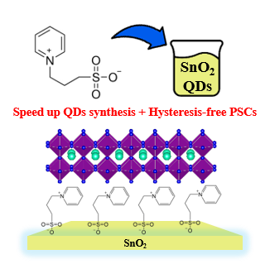
UNIVERSITY OF NAPOLI “FEDERICO II”
POLYTECHNIC AND SCIENCE SCHOOL
Department of Chemical Sciences
Ph.D. School in Chemical Sciences (XXXVI Cycle)
Third year activity
Novel additive for the synthesis of SnO₂ quantum dots (QDs), performing a multifunctional role by accelerating the synthesis of the QDs and passivating defects at the SnO₂-perovskite interface. |  | Ph.D. Student Gennaro Vincenzo Sannino Title Optimizing SnO₂ Quantum Dot Precursor Solutions for Perovskite Solar Cells with Reduced Hysteresis

