Slide 1




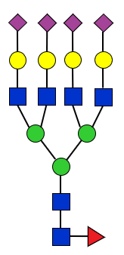
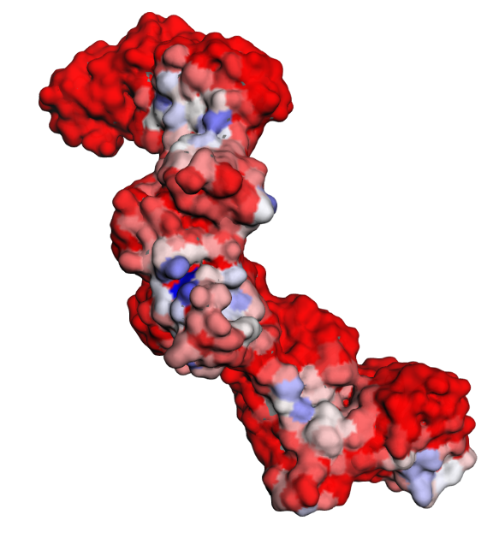
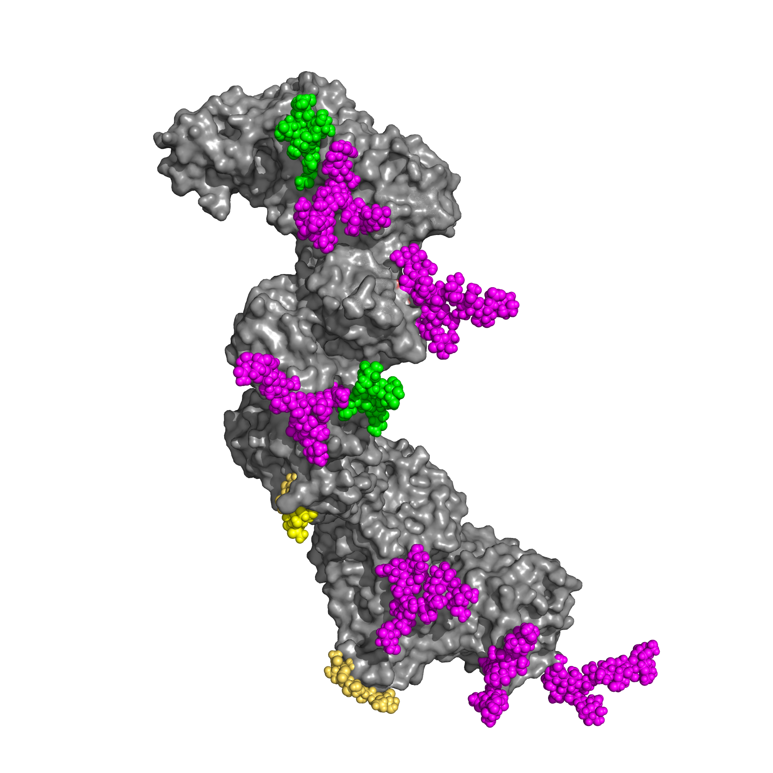
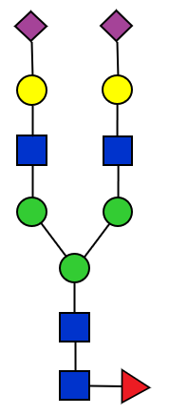





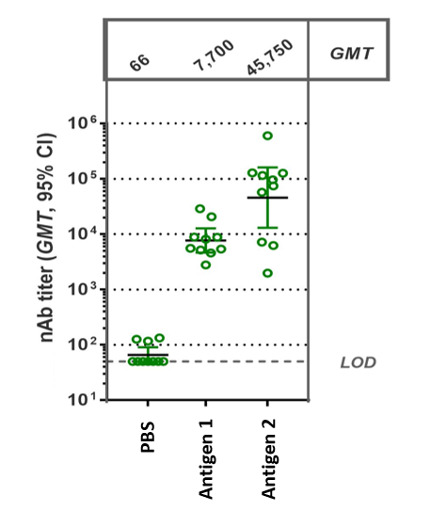


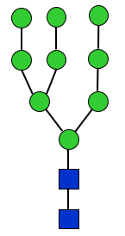
UNIVERSITY OF NAPOLI “FEDERICO II”
POLYTECHNIC AND SCIENCE SCHOOL
Department of Chemical Sciences
Ph.D. School in Chemical Sciences (XXXVII Cycle)
Third year activity Development and analysis of glycoprotein based antiviral vaccines through Mass-Spectrometry
Internal standard method
Epitopes shielding assessment
A_{X}/A_{ISTD}
5 %
PNGaseF
55 %
C_{X}/C_{ISTD}
10 %
H⁺
Immunogenicity
Δ
2 %
15 %
Monosaccharide analysis
GC-MS/LC-UV-MS
0.5 %
...
...
Glycoprotein antigen
Ph.D. Student
Antonio Lembo
Released glycans analysis
Glycans site-specific analysis
LC-FLR-MS
LC-MS/MS

