Slide 1


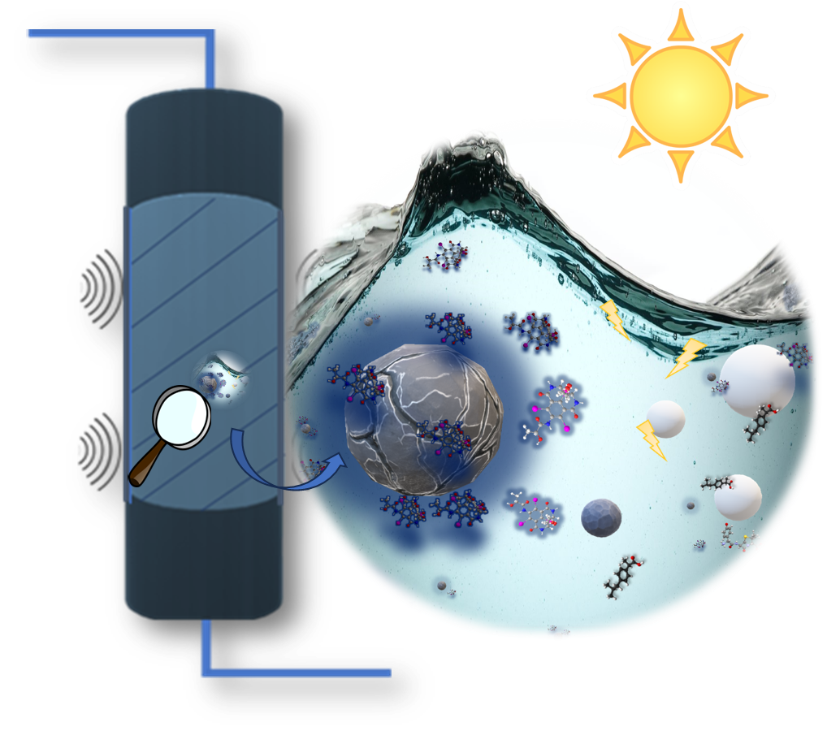
UNIVERSITY OF NAPOLI “FEDERICO II”
POLYTECHNIC AND SCIENCE SCHOOL
Department of Chemical Sciences
Ph.D. School in Chemical Sciences (XXXVII Cycle)
Third year activity
Process intensification for removal of new pharmaceutical compounds from water: adsorption and photodegradation techniques. |  | Ph.D. Student Rosanna Paparo Title New technological approaches to remove pharmaceutical compounds from water

