Slide 1




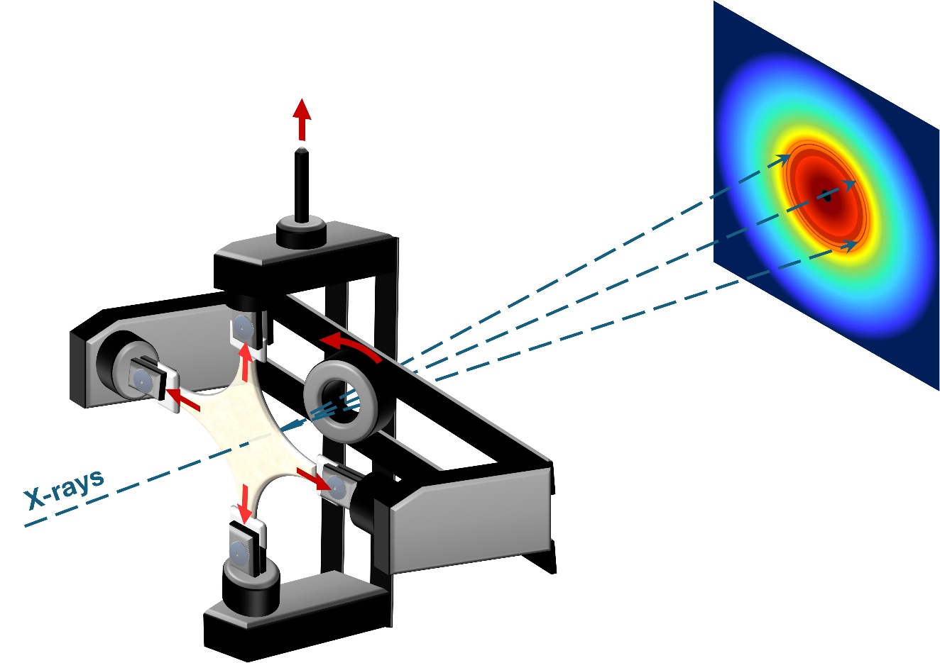


UNIVERSITY OF NAPOLI “FEDERICO II”
POLYTECHNIC AND SCIENCE SCHOOL
Department of Chemical Sciences
Ph.D. School in Chemical Sciences (XXXVII Cycle)
Third year activity
PER-MANENT
A microstructural insight in PolyEthylene based bioRiented mono-MAterials: from fuNdamENTal to processing
Ph.D. Student: Adriano Guida
BOPEs are promising candidate as the next generation's reference film as a sustainable mono-material
In-situ analysis help to elucidate the mechanism of structural evolution occurring in PE during simultaneous biaxial stretching

