Slide 1


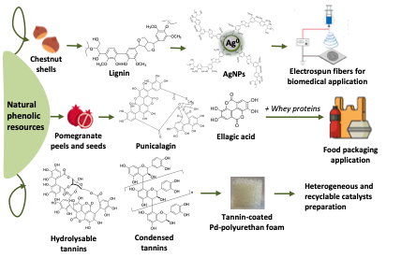
UNIVERSITY OF NAPOLI “FEDERICO II”
POLYTECHNIC AND SCIENCE SCHOOL
Department of Chemical Sciences
Ph.D. School in Chemical Sciences (XXXVII Cycle)
Third year activity
The third-year research activity has been directed to the recovery of lignin from chestnut shells to be exploited as functional additives in biocompatible materials for biomedical applications, and of ellagitannins from pomegranate processing by-products to be used in combination with whey proteins for food packaging applications. Wood tannins were instead investigated for the preparation of palladium–functionalized polyurethane foams to be used as heterogeneous and recyclable catalysts. |  | Ph.D. Student Sara Viggiano Title “Natural and bio-inspired phenolic polymers for the design of innovative functional materials: tailoring properties by ad hoc synthesis and chemical manipulation.“

