Slide 1


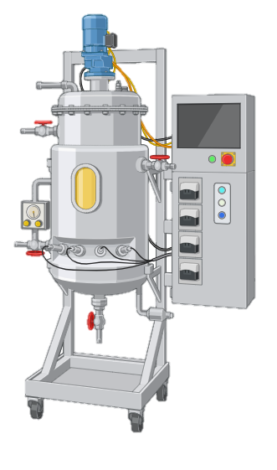
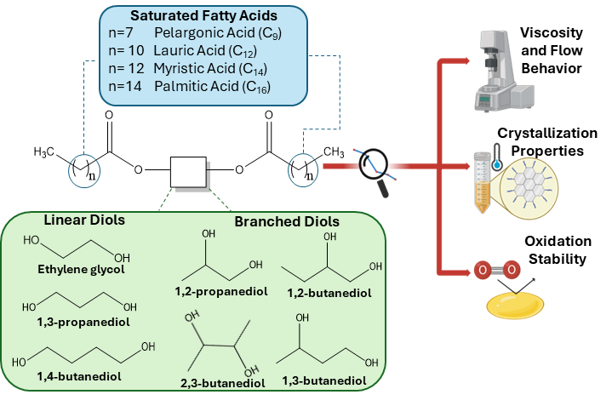

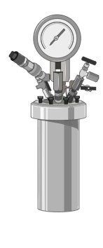


UNIVERSITY OF NAPOLI “FEDERICO II”
POLYTECHNIC AND SCIENCE SCHOOL
Department of Chemical Sciences
Ph.D. School in Chemical Sciences (XXXVII Cycle)
Third year activity
 |  | Ph.D. Student Michele Emanuele Fortunato Title Structure-properties relationships of diol diesters from saturated fatty acid and pilot batch reactor testing for UCO-based lubricant synthesis
I. Structure properties relationships of diol diesters
II. UCO-based lubricants synthesis
process scale up
in collaboration with

