Slide 1


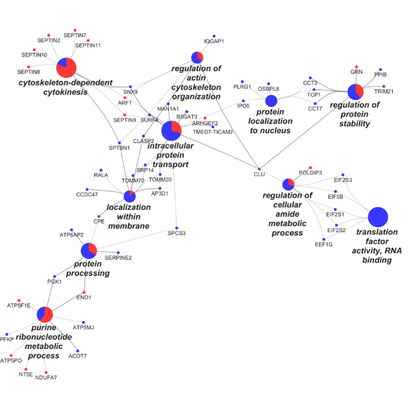
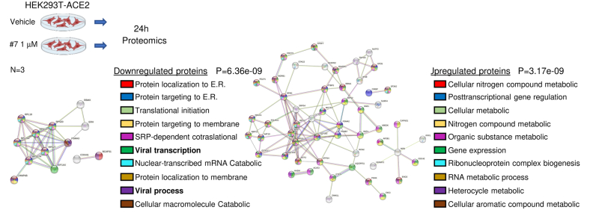
UNIVERSITY OF NAPOLI “FEDERICO II”
POLYTECHNIC AND SCIENCE SCHOOL
Department of Chemical Sciences
Ph.D. School in Chemical Sciences (37° Cycle)
Third year activity
 |  | Ph.D. Student: Vittoria Monaco Title Study of the molecular mechanisms relevant in the interactions between pathogens and hosts
Spike-S2 Interactomes investigation
Investigation of antiviral drugs
The proteomic investigation of S2 interactomes in different cell lines (HEK-293T and Calu-3) demonstrated its involvement in the membrane remodeling for the viral entry, trafficking, and spread inside the host cells.
Preliminary studies on the effects of a potential antiviral drug were carried out using a differential proteomic approach, leading to a hypothesis on the mode of action of these molecules.

