Slide 1





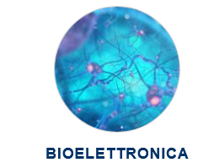

UNIVERSITY OF NAPOLI “FEDERICO II” POLYTECHNIC AND SCIENCE SCHOOL
Department of Chemical Sciences
Ph.D. School in Chemical Sciences (XXXVII Cycle)
Second year activity
A series of new eumelanin-based compounds with the incorporation of calchogen elements were synthesized according to innovative synthetic procedures. 3-selenoglycosidic eumelanin (1) These compounds were designed to enhance the physicochemical and biological properties of the final polymers for bioelectronic applications. | Ph.D. Student: Emanuele Carrella Title: Smart Electronic Platforms: bioelectronic devices on bioinspired conformable substrates.
S
Se
New calchogen-functionalised Eumelanin and related products
O-deacetylation
Oxidation
S
Se

