Slide 1


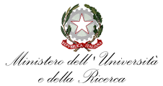


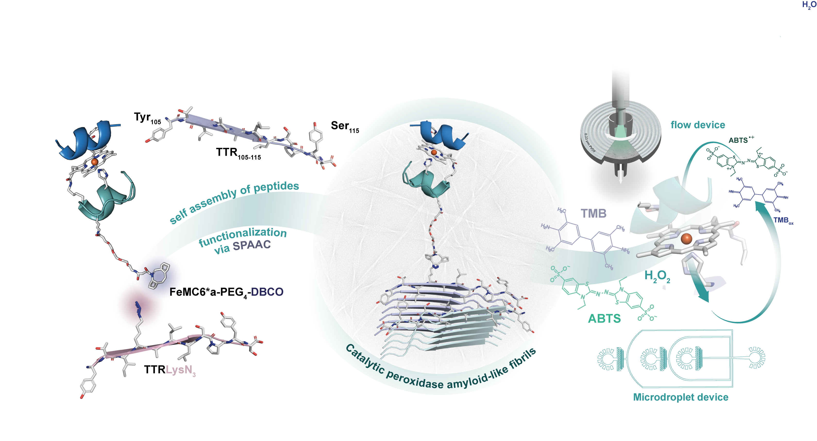
UNIVERSITY OF NAPOLI “FEDERICO II”
POLYTECHNIC AND SCIENCE SCHOOL
Department of Chemical Sciences
Ph.D. School in Chemical Sciences (XXXVII Cycle)
Second year activity
Development of catalytic amyloid fibrils suitable for the construction of complex devices acting as biosensors, drug delivery systems and catalysts
Ph.D. Student
Alessandra Esposito
Title
Amyloid fibrils for the construction of innovative, safe and sustainable functional materials

