Slide 1


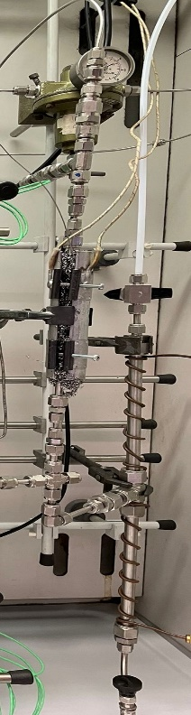
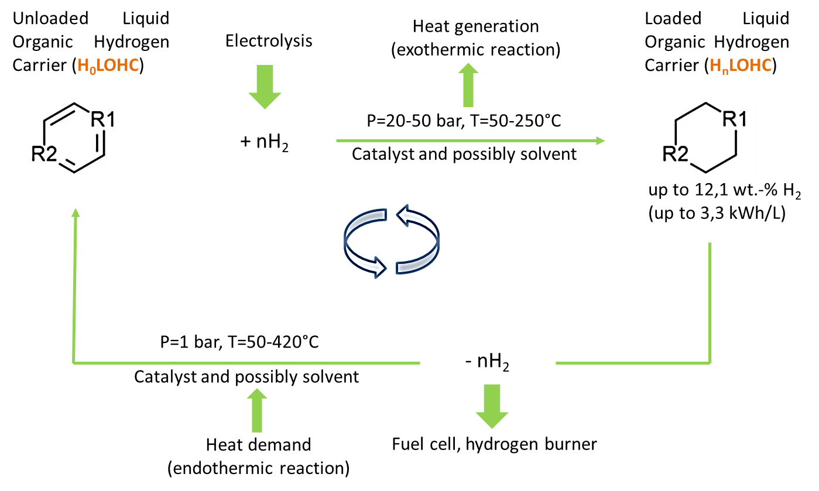
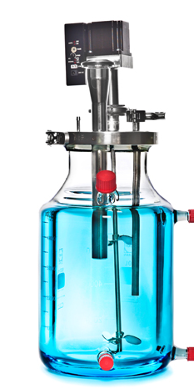
UNIVERSITY OF NAPOLI “FEDERICO II”
POLYTECHNIC AND SCIENCE SCHOOL
Department of Chemical Sciences
Ph.D. School in Chemical Sciences (XXXIX Cycle)
Project Presentation
Ph.D. Student
Muhammad Usama Daud
Title
Hydrogen storage and
transportation through coupling
of hydrogenation-dehydrogenation
reactions of unsaturated organic
substrates
Analysis of the products of the hydrogenation and dehydrogenation reactions of LOHC system;
Catalysts screening;
Kinetic study;
Batch-to-continuous reactor design.
BATCH
TO CONTINUOUS REACTOR DESIGN

