Slide 1
Ketoprofen photodegradation
Ciro esposito
University of naples federico ii
Bsc degree in industrial chemistry

Slide 2

Ciro Esposito
Personal data
education
02/05/2000
Naples, Italy
B2 certified by IELTS
BSc degree in Industrial Chemistry
Date: 12/12/2022
University of Naples Federico II
Thesis Title: Ketoprofen photodegradation
Topic: Industrial Chemistry
110/110

Slide 3
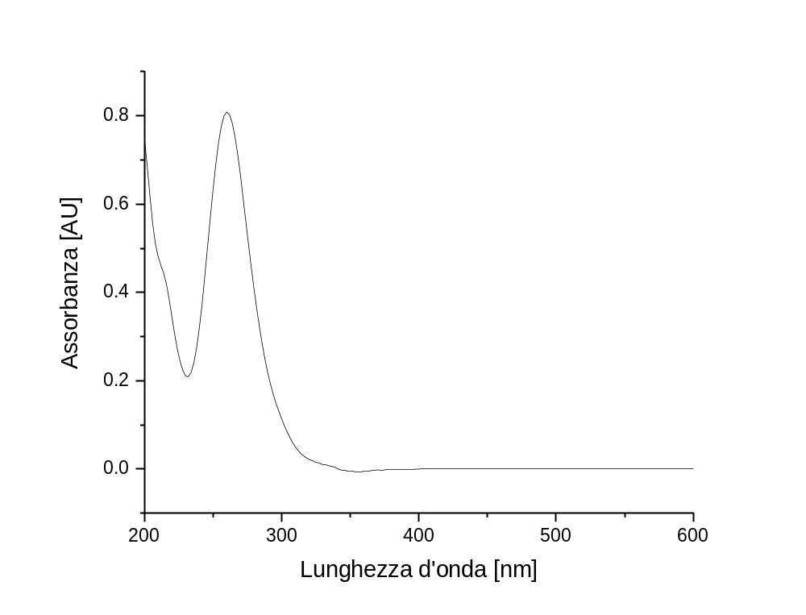
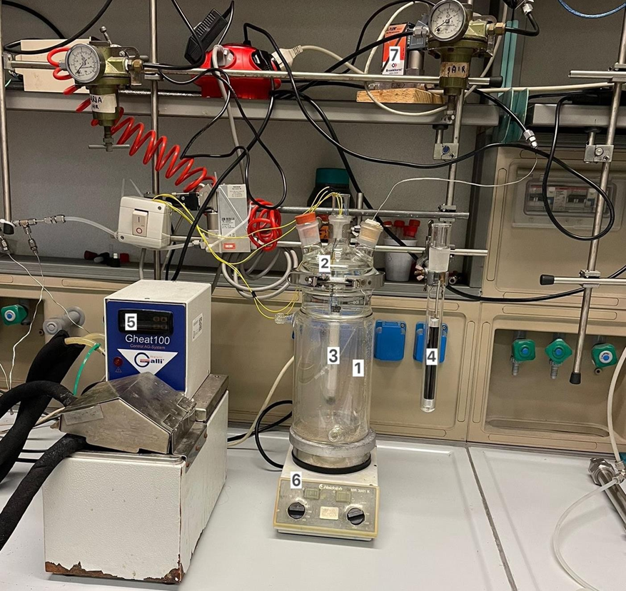
Methods
Chemical reactor for photodegradation tests
Chemical analysis via UV/Vis spectrophotometry
Ketoprofen UV/Vis spectrum

Slide 4
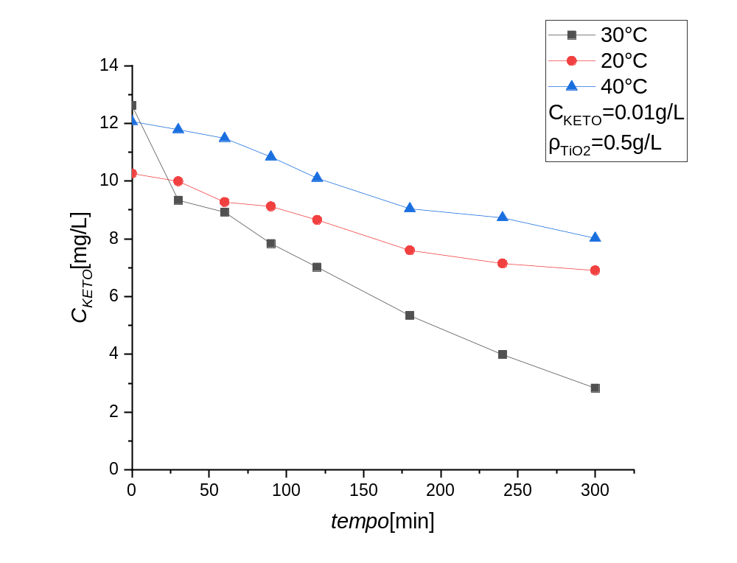
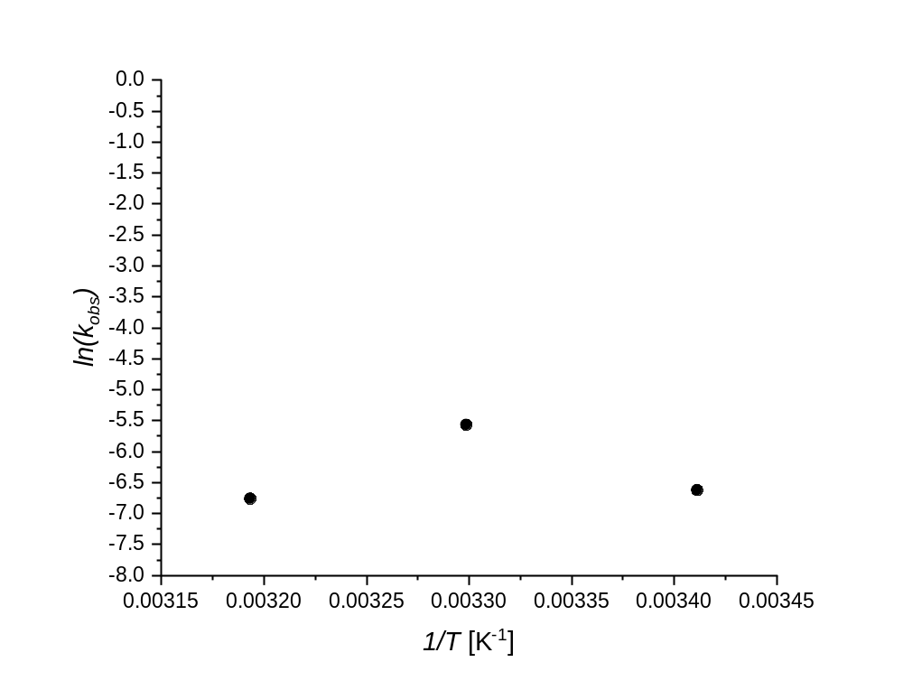

Obtained results
$$r_{ER}=\frac{kK_{K}C_{K}C_{O_{2}}}{\left(1+K_{K}C_{K}\right)}$$
$$kK_{K}=k_{0}e\left(−\frac{E_{a}}{RT}\right)K_{K0}e\left(−\frac{∆H}{RT}\right)=k_{0}K_{K0}e\left(−\frac{E_{a}+∆H}{RT}\right)=k_{0}K_{K0}e\left(−\frac{E_{a,app}}{RT}\right)$$

Slide 5
Conclusions
It has been demonstrated that ketoprofen is stable in photodegradation tests in the presence of visible light, while there is a marked photodegradation effect in the presence of UV radiation.
The kinetic tests have shown for all the tests carried out a decrease in the concentration of ketoprofen in the solution is observed with increasing time and a faster degradation with the increase in the mass of catalyst.
From the data analysis it was possible to discriminate an Eley-Rideal type mechanism, where ketoprofen reacts after adsorption while oxygen from the bulk of the liquid phase.

